Slide 1
2CEIT302
Object Oriented Programming
GANPAT UNIVERSITY
U. V. PATEL COLLEGE OF ENGINEERING
UNIT 10
Applets
Prepared by: Prof. Y. J. Prajapati (Asst. Prof in IT Dept. , UVPCE)

Slide 2
Outline
Applet Basics, Methods of Building an Applet
Displaying Text in Status Bar,
The HTML Applet Tag, Reading Parameters into Applets, Colors in Applet, Getting Document base and Codebase
Interfaces in Applet, Multimedia in Applet (Playing Audio Clips, Images in Applet, Applet Showing Other HTML Pages)

Slide 3
Applet Basics
An applet is a Java program that runs in a Web browser.
It runs inside the browser and works at client side.
Applet is embedded in a HTML page using the APPLET or OBJECT tag and hosted on a web server.
Applets are used to make the web site more dynamic and entertaining.
Important points :
All applets are sub-classes (either directly or indirectly) of java.applet.Applet class.
Applets are not stand-alone programs. Instead, they run within either a web browser or an applet viewer. JDK provides a standard applet viewer tool called applet viewer.
In general, execution of an applet does not begin at main() method.
Output of an applet window is not performed by System.out.println(). Rather it is handled with various AWT methods, such as drawString().

Slide 4
Java Applet vs Java Application
Java Application | Java Applet
Java Applications are the stand-alone programs which can be executed independently | Java Applets are small Java programs which are designed to exist within HTML web document
Java Applications must have main() method for them to execute | Java Applets do not need main() for execution
Java Applications just needs the JRE | Java Applets cannot run independently and require API’s
Java Applications do not need to extend any class unless required | Java Applets must extend java.applet.Applet class
Java Applications can execute codes from the local system | Java Applets Applications cannot do so
Java Applications has access to all the resources available in your system | Java Applets has access only to the browser-specific services

Slide 5
Applet Hierarchy in Java
class java.lang.Object
  class java.awt.Component
    class java.awt.Container
      class java.awt.Panel
        class java.applet.Applet
Java Applet class which is a class of applet package extends the Panel class of awt package. The Panel class is a subclass of the Container class of the same package. The Container class is an extension of Component class belonging to the same package. The Component class is an abstract class and derives several useful classes for the components such as Checkbox, List, buttons, etc.

Slide 6
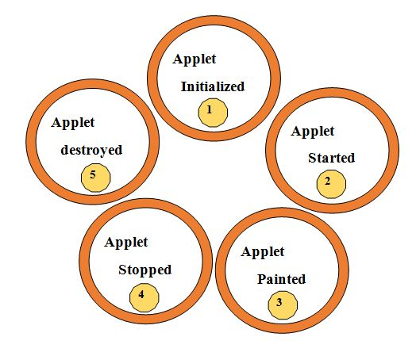
Life Cycle of an Applet
Applet is initialized.
Applet is started.
Applet is painted.
Applet is stopped.
Applet is destroyed.

Slide 7
Lifecycle methods for Applet
public void init(): is used to initialized the Applet. It is invoked only once.
public void start(): is invoked after the init() method or browser is maximized. It is used to start the Applet.
public void paint(Graphics g): is used to paint the Applet. It provides Graphics class object that can be used for drawing oval, rectangle, arc etc.
public void stop(): is used to stop the Applet. It is invoked when Applet is stop or browser is minimized.
public void destroy(): is used to destroy the Applet. It is invoked only once.

Slide 8
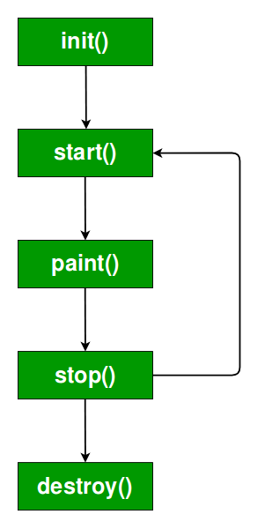
Lifecycle methods for Applet
It is important to understand the order in which the various methods shown in the above image are called. When an applet begins, the following methods are called, in this sequence:
init( )
start( )
paint( )
When an applet is terminated, the following sequence of method calls takes place:
stop( )
destroy( )

Slide 9
How to run an Applet ?
There are two ways to run an applet
By html file.
By appletViewer tool (for testing purpose).
Simple example of Applet by html file:
create an applet and compile it.
After that create an html file and place the applet code in html file.
//First.java
import java.applet.Applet;
import java.awt.Graphics;
public class First extends Applet
{
public void paint(Graphics g){
g.drawString("welcome",150,150);
}
}
myapplet.html
<html>
<body>
<applet code="First.class" width="300" height="300">
</applet>
</body>
</html>

Slide 10
Applet by appletviewer tool
To execute the applet by appletviewer tool, create an applet that contains applet tag in comment and compile it. After that run it by: appletviewer First.java.
//First.java
import java.applet.Applet;
import java.awt.Graphics;
public class First extends Applet
{
public void paint(Graphics g)
{
g.drawString("welcome to applet",150,150);
}
}

Slide 11
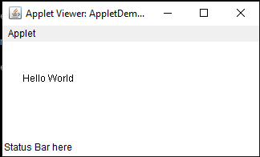
Displaying Text in Status Bar
AppletDemo.java
import java.applet.*;
import java.awt.*;
public class AppletDemo extends Applet {
public void paint (Graphics g) {
g.drawString ("Hello World", 25, 50);
showStatus("Status Bar here");
}
}
Hello.html
<html>
<title>The Hello, World Applet</title>
<hr>
<applet code = "AppletDemo.class" width = "320" height = "120">
If your browser was Java-enabled, a "Hello, World"
message would appear here.
</applet>
<hr>
</html>

Slide 12
Displaying Graphics in Applet
public abstract void drawString(String str, int x, int y): is used to draw the specified string.
public void drawRect(int x, int y, int width, int height): draws a rectangle with the specified width and height.
public abstract void fillRect(int x, int y, int width, int height): is used to fill rectangle with the default color and specified width and height.
public abstract void drawOval(int x, int y, int width, int height): is used to draw oval with the specified width and height.
public abstract void fillOval(int x, int y, int width, int height): is used to fill oval with the default color and specified width and height.
public abstract void drawLine(int x1, int y1, int x2, int y2): is used to draw line between the points(x1, y1) and (x2, y2).

Slide 13
public abstract boolean drawImage(Image img, int x, int y, ImageObserver observer): is used draw the specified image.
public abstract void drawArc(int x, int y, int width, int height, int startAngle, int arcAngle): is used draw a circular or elliptical arc.
public abstract void fillArc(int x, int y, int width, int height, int startAngle, int arcAngle): is used to fill a circular or elliptical arc.
public abstract void setColor(Color c): is used to set the graphics current color to the specified color.
public abstract void setFont(Font font): is used to set the graphics current font to the specified font.

Slide 14
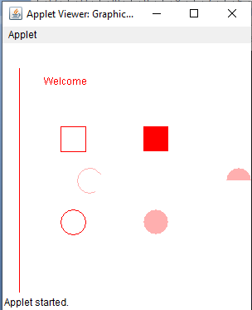
Example of Graphics in applet
import java.applet.Applet;
import java.awt.*;
public class GraphicsDemo extends Applet{
public void paint(Graphics g){
g.setColor(Color.red);
g.drawString("Welcome",50, 50);
g.drawLine(20,30,20,300);
g.drawRect(70,100,30,30);
g.fillRect(170,100,30,30);
g.drawOval(70,200,30,30);
g.setColor(Color.pink);
g.fillOval(170,200,30,30);
g.drawArc(90,150,30,30,30,270);
g.fillArc(270,150,30,30,0,180);
}
}
Html file
<html>
<body>
<applet code="GraphicsDemo.class" width="300" height="300">
</applet>
</body>
</html>

Slide 15
Displaying Image in Applet
Applet is mostly used in games and animation. For this purpose image is required to be displayed. The java.awt.Graphics class provide a method drawImage() to display the image.
public URL getDocumentBase(): is used to return the URL of the document in which applet is embedded.
public URL getCodeBase(): is used to return the base URL.
import java.awt.*;
import java.applet.*;
public class DisplayImage extends Applet {
Image picture;
public void init() {
picture = getImage(getDocumentBase(),"sonoo.jpg");
}
public void paint(Graphics g) {
g.drawImage(picture, 30,30, this);
}
}

Slide 16
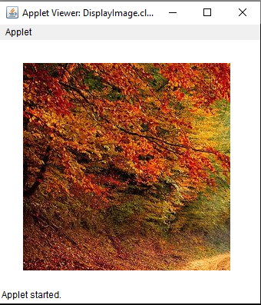
<html>
<body>
<applet code="DisplayImage.class" width="300" height="300">
</applet>
</body>
</html>

Slide 17
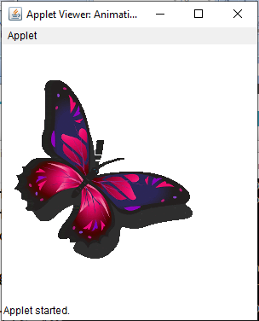
Animation in applet
import java.awt.*;
import java.applet.*;
public class AnimationExample extends Applet {
Image picture;
public void init() {
picture =getImage(getDocumentBase(),"butterfly.gif");
}
public void paint(Graphics g) {
for(int i=0;i<50;i++){
g.drawImage(picture, i,30, this);
try{Thread.sleep(100);}catch(Exception e){}
}
}
}
<html>
<body>
<applet code="DisplayImage.class" width="300" height="300">
</applet>
</body>
</html>

Slide 18


